Slide 1
Does the technology acceptance model predict actual use? A systematic literature review
Mark Turner,
Barbara Kitchenham,
Pearl Brereton,
Stuart Charters,
David Budgen
ÇAĞRI KARAPIÇAK
1777697
02.04.2015

Slide 2
CONTEXT
The technology acceptance model (TAM) was proposed in 1989 as a means of predicting technology usage.
However, it is usually validated by using a measure of behavioral intention to use (BI) rather than actual usage.
OBJECTIVE
Examine the evidence that the TAM predicts actual usage using both subjective and objective measures of actual usage.

Slide 3
METHOD
A systematic literature review based on a search of six digital libraries, along with vote-counting meta-analysis to analyze the overall results.
RESULTS
The search identified 79 relevant empirical studies in 73 articles. The results show that BI is likely to be correlated with actual usage.
TAM variables perceived ease of use (PEU) and perceived usefulness (PU) are less likely to be correlated with actual usage.

Slide 4
CONCLUSION
Care should be taken using the TAM outside the context in which it has been validated.

Slide 5
BACKGROUND
TAM was proposed by Davis and Davis et al. On 1989.
Theory of reasoned action:
Technology acceptance and use can be explained in terms of a user’s internal beliefs, attitudes and intentions.
TAM Variables impact actual usage:
Perceived ease of use (PEU)
Perceived usefulness (PU)
Attitude toward use (A)
Behavioural intention to use (BI).

Slide 6
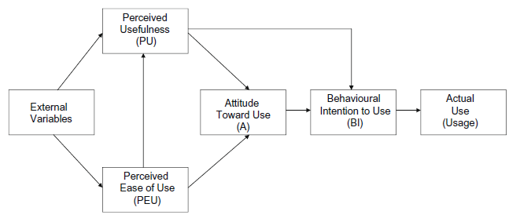
THE ORIGINAL TAM MODEL

Slide 7
TAM INVESTIGATIONS
TAM assessments are often accepted as being accurate predictors of usage and adoption.
Many studies also investigated whether TAM is an accurate predictor of actual use rather than behavioral intention to use.
TAM produced different results in a study if the users being questioned have
used the technology being tested previously
a choice in whether to use the technology.

Slide 8
ACTUAL USAGE MEASUREMENT
The actual usage of a technology can be measured using both objective and subjective forms.
Objective Measures:
Logs from computers
Delivery orders from supermarkets, etc
Subjective Measures:
Survey results from users of technology.

Slide 9
AIM OF THE REVIEW
Straub et al. investigated and reported that;
Self-reported measures of TAM variables (such as PU and PEU)
Related to self-reported measures of actual usage.
Weaker relationship with objective measures of actual usage.
Investigate the findings of Straub et al.
Assess whether the TAM is an accurate predictor of actual usage when employing objective and subjective forms of usage measure.
Investigate if other factors may influence the results of a TAM study, particularly mandatory technology usage or prior use of a technology.

Slide 10
METHOD (Formal Systematic Literature Review Process)
Research Questions
Search Strategy
Study selection criteria and procedures
Included and excluded studies
Study quality assessment
Data extraction strategy
Data aggregation

Slide 11
RESEARCH QUESTIONS
Question 1: To what extent are the TAM and its revisions capable of accurately predicting the actual usage of a technology and, as an ancillary question, to what extent are the TAM and its revisions capable of accurately predicting the behavioral intention (BI) to use a technology?
Question 2: Does the type of actual usage measure (subjective or objective) affect the accuracy of TAM predictions?
Question 3: Do factors such as the version of the TAM, the form of technology being evaluated, prior use of the technology or whether the technology is mandatory or not affect the accuracy of the predictions? (Eliminated during study)

Slide 12
SEARCH STRATEGY
Search string :
‘‘technology acceptance model” AND
(usage OR use OR empirical) AND
(year > 1988 AND year < 2007)
Digital libraries used :
IEEE Xplore, ACM Portal, Google Scholar, CiteSeer library, Science Direct, ISI Web of Science.
Search is validated by their ability to detect a number of known primary studies.
2 reviewers searched (3 for both)
Different syntax used for different libraries.

Slide 13
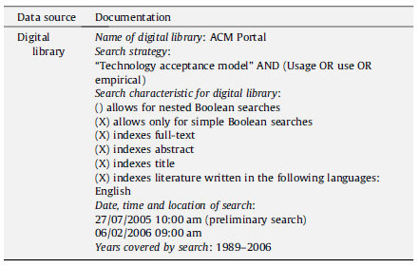
Search Process Documentation for ACM Portal

Slide 14
STUDY SELECTION (Inclusion Criteria)
TAM was applied to any technology.
TAM actual usage variable is measured.
Version of TAM including PEU/PU and their relationship to actual usage.
BI and actual usage relation.
Several independent studies are reported in the same publication.

Slide 15
STUDY SELECTION (Exclusion Criteria)
Do not report on the TAM in relation to actual usage.
Based solely on the BI to use a technology.
Theoretical publications.
Only an abstract or a PowerPoint slideshow are available.
One of four secondary reviewer’s comment is taken on uncertain cases.

Slide 16
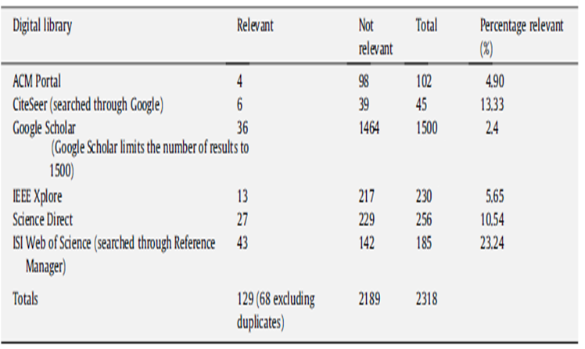
INCLUDED and EXCLUDED STUDIES

Slide 17
INCLUDED and EXCLUDED STUDIES
75 studies selected.
Same data set usage is investigated.
Same author studies are investigated.
68 of 75 were selected for final review.
The papers referenced in these studies are also checked for relevance.
The final studies are also checked against the study by Legris et al. (added 5 new)
At last 73 publications were selected at last.

Slide 18
STUDY QUALITY ASSESSMENT
Size of samples used effected the results or not?
Other confounding factors influenced the relationship between TAM variables and actual usage.
How actual usage was measured?
Is the information required from the study directly extractable? (i.e. Correlation,regression value with the statistical significance reporting needed).

Slide 19
DATA EXTRACTION STRATEGY
One data extraction form was completed per study and not per publication.
One study, three publication->One data extraction form.
One publication, three study->Three data extraction form.

Slide 20
PRIMARY STUDY DATA
For RQ1 (TAM capability to predict actual usage)
PU/PEU association with actual usage. (p<0.05)
PU and PEU association with BI. (p < 0.05)
Enables assessment of studies similarities not reporting actual usage.
BI association with actual usage (p < 0.05)
If BI is a surrogate for actual usage or not!
For RQ2 (Effect of actual usage measurements on TAM prediction accuracy)
Whether different measures were collected.
Whether it was objective or subjective.

Slide 21
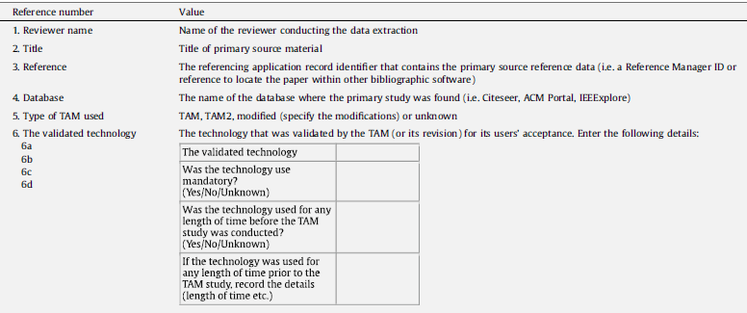
DATA EXTRACTION FORM

Slide 22
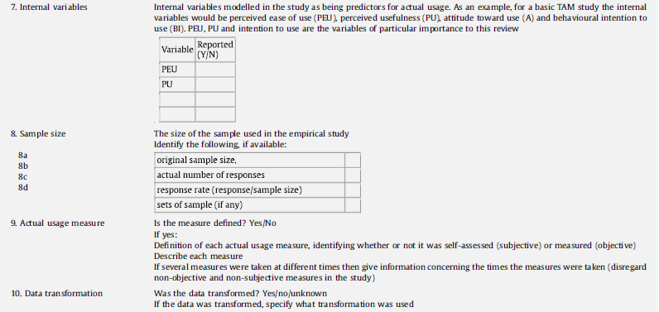
DATA EXTRACTION FORM (cont’d)

Slide 23
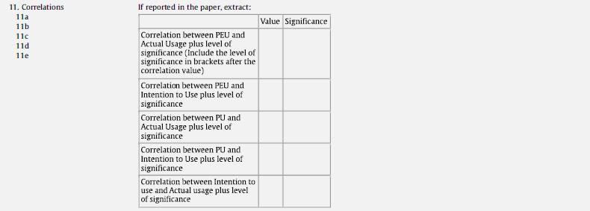
DATA EXTRACTION FORM (cont’d)

Slide 24
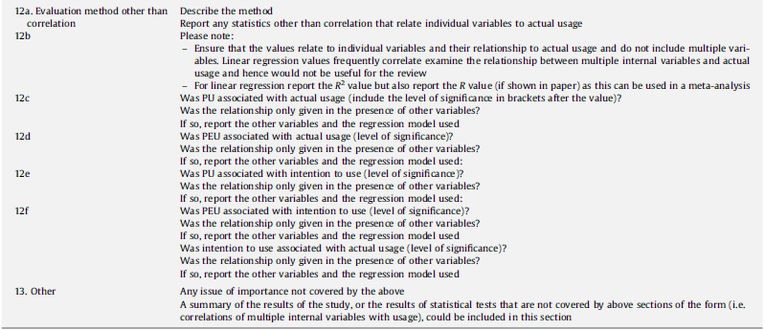
DATA EXTRACTION FORM (cont’d)

Slide 25
DATA EXTRACTION PROCESS
Each primary study is read by two primary reviewers.
One extracted data, and the other reviewed.
If needed third reviewer is used. (14 times)
Correlation matrices needed to perform meta-analysis but very few of the studies have given these data.
Number of decisions and manual calculations like correlation or significance level were made for filling data extraction forms.
If several TAM tests used in a study in different times, all extracted but treated as non-independent tests within a single study.

Slide 26
DATA AGGREGATION PROCESS
First plan was to perform an effect-size based meta analysis of the primary study where a meta-analysis is a synthesis of the results indicating actual effect size.
But, due to the heterogeneity of reporting of the primary studies in terms of the type of TAM used or the statistical method, it was not possible to undertake a full effect-size meta-analysis and so a vote-counting meta analysis was employed.

Slide 27
RESULTS OF RQ1
RQ1:To what extent are the TAM and its revisions capable of accurately predicting the actual usage of a technology and to what extent are the TAM and its revisions capable of accurately predicting the behavioral intention (BI) to use a technology?
Key Point: Many tests conducted in studies and they are not independent! For solving side effects, they have calculated;
Proportion of tests in which PU, PEU and BI predict Actual Usage. (p<0.05)
Proportion of tests in which PU, PEU predict BI. (p<0.05)
This refers to as the proportion of the successful tests per study.
Average calculated across all studies for each association. (PU to actual usage and PEU to actual usage)

Slide 28
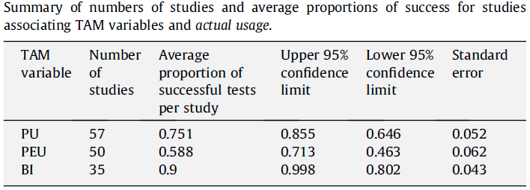
Average proportions of success (TAM variables & actual usage)
PEU is not as successful at predicting actual usage as BI!!!

Slide 29

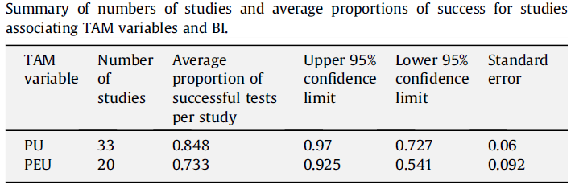
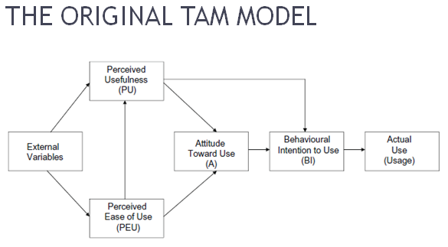
Average proportions of success (TAM variables & BI)
Compare with the previous slide!
TAM variables are a much stronger predictor of the behavioral intention to use a technology than the actual usage of a technology.
But, very few studies on this (only 20 studies) because of TAM does not have association between PEU and BI .
So, It is not possible to determine a statistically significant difference between the results for the TAM variables and actual usage and those of the TAM variables and BI!

Slide 30
RESULTS OF RQ2
RQ2: Does the type of actual usage measure (subjective or objective) affect the accuracy of TAM predictions?
TAM variables association with subjective measures of actual usage is investigated!
TAM variables association with objective measures of actual usage is investigated!

Slide 31
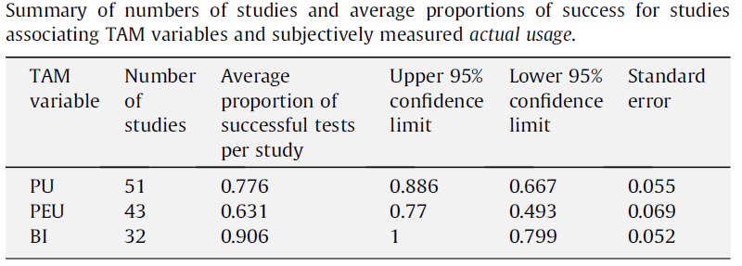
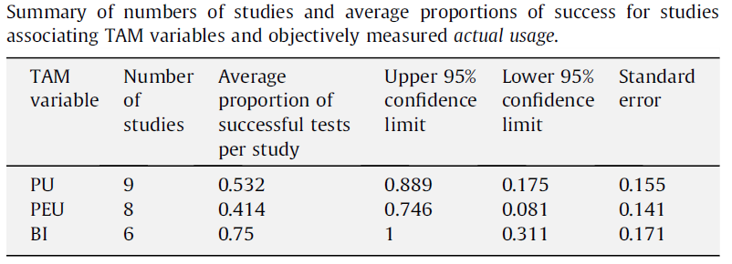
Largest Difference
Few Studies!!!

Slide 32
RESULTS OF RQ2 (cont’d)
It is not possible to confirm if the differences are statistically significant (p < 0.05).
The average proportion of all of the three TAM variables predicting actual usage is lower if the actual usage measure is objective than if it is subjective.

Slide 33
SENSITIVITY ANALYSIS-1
Other variables effect study or not?
Any tests that failed in models that included extra variables other than PU, PEU, BU and actual usage were classified as ‘failing in the presence of other variables’.
These tests are removed from calculations.

Slide 34
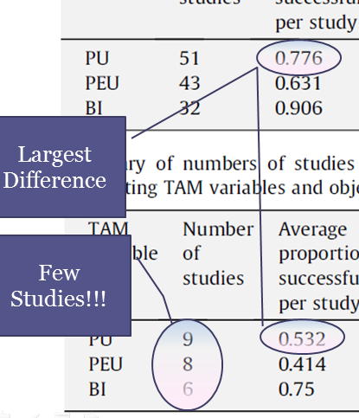
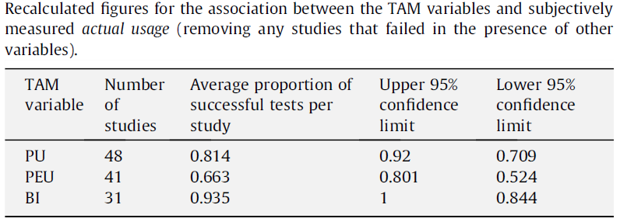
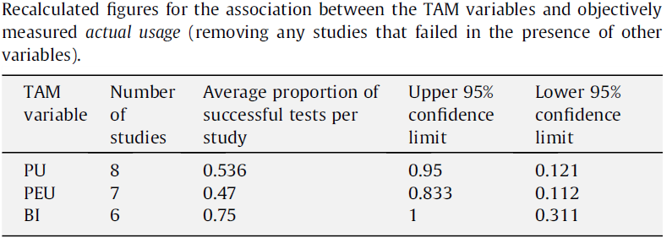
AFTER REMOVING...
REMEMBER:
Only Minor Differences Exist!!!
Results suggest that estimates of the frequency of TAM variables predicting actual usage are quite stable with respect to incomplete information or the negative
effect of other, non-tested, variables in the models.

Slide 35
SENSITIVITY ANALYSIS-2
Dataset size of studies effect study or not?
Are small datasets caused non-significant relationships?

Slide 36
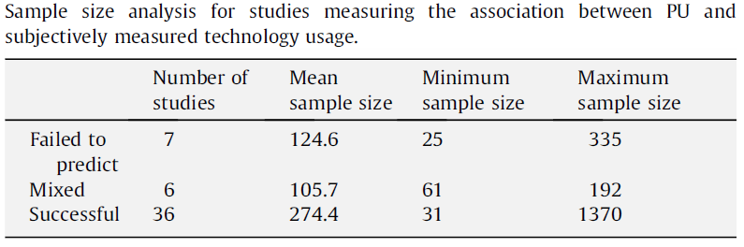
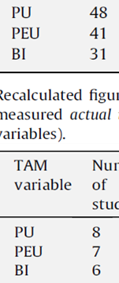
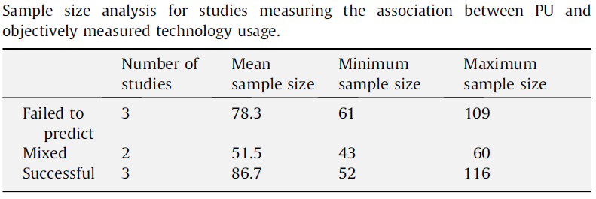
PU:ACTUAL USE
Study included multiple tests, some that failed and some that showed a positive association.
Any correlation could not be found!
REMEMBER:

Slide 37
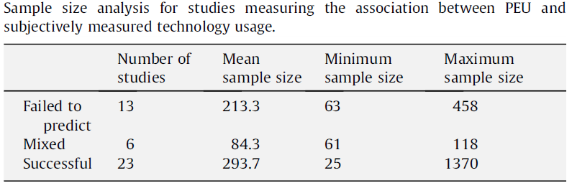
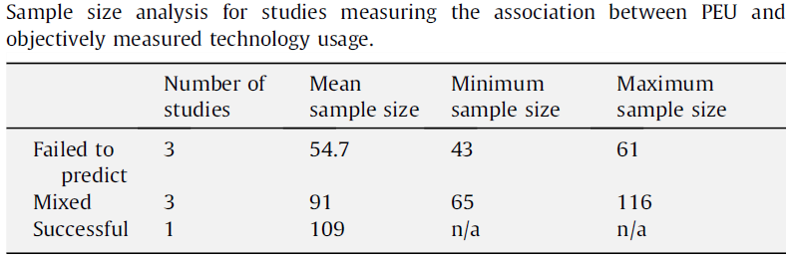
PEU:ACTUAL USE
Any correlation could not be found again.
So, concluded that the sample sizes were
sufficient to have confidence in the results

Slide 38
SENSITIVITY ANALYSIS-3
Davis’s studies effect study or not?
Remove Davis’s studies as an author or co-author for studies that measured actual usage objectively.

Slide 39
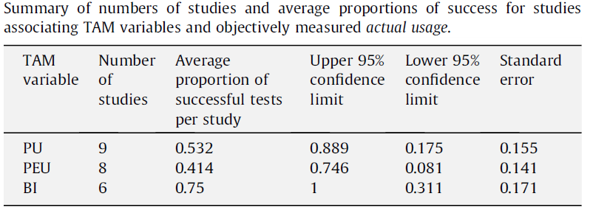
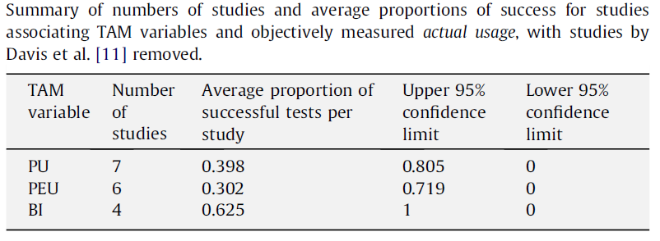
WITH/WITHOUT DAVIS?
Effect on the relationship of all of the TAM variables to objectively measured usage exists!!!

Slide 40
DISCUSSION
Limitations of the primary studies for SLRs
Vote-counting meta-analysis could be conducted.
Same studies in multiple publications. (removed)
Research questions
PU and PEU are worse predictors of actual usage than BI, with PEU being significantly worse than BI.
All TAM variables are worse predictors of objective usage than subjective usage.
Under what conditions PU or PEU are (or are not) good predictors?

Slide 41
DISCUSSION (cont’d)
PU explains part of the variation in BI and BI explains part of the variation in actual usage, but they could each explain a different part of the variation, meaning that it cannot be assumed that there is an association between PU and actual Usage.
Comparison with related work
Some SLRs data is given.
Similarity with the study by Legris et al.
They found that; TAM variables PU and PEU were worse predictors of actual usage than BI and, of the two variables, PU was a slightly better predictor.
They found that direct relationships between PEU and PU and actual usage were not always recorded.
They covered studies published up to the first half of 2001, whereas this review covers papers published to the end of 2006.

Slide 42
DISCUSSION (cont’d)
General limitations of the TAM
TAM does not measure the benefit of using a technology.
Measures of technology usage are themselves surrogates for measures of technology value.
Technology adopters need to measure the impact of technology on work performance. (productivity, effectiveness, etc.)
Threats to validity
Search strategy (keywords, limitations of search engines) (tried to eliminate)
Studies published before 2006 included only.
Since they have been unable to undertake a formal meta analysis, they are equally unable to undertake a funnel analysis to investigate the possible extent of publication bias.

Slide 43
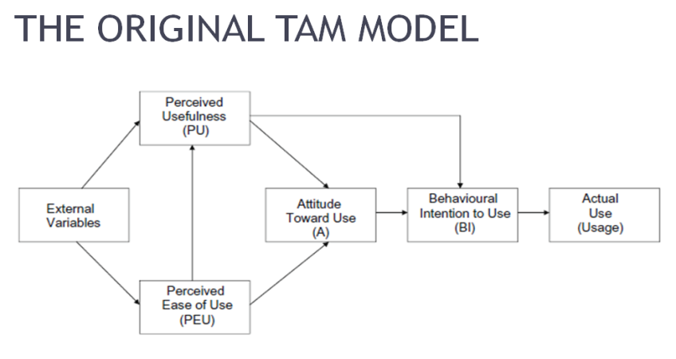
CONCLUSIONS
Implications for the TAM
It is important to measure actual use objectively as there is a difference in the relationship between the TAM variables and subjective and objective measures of actual technology use.
They recommend objective measures of actual technology.
PU, and particularly PEU, are not as good at predicting actual technology use as BI.
They recommend future research investigating the limits of the applicability of the TAM include usage measures and technology benefit measures.
They were unable to identify any factors that contribute to the accuracy (or otherwise) of PU and PEU as predictors of usage, recommending more contextual information about the technology being evaluated and the populations being sample in future studies.

Slide 44
CONCLUSIONS (cont’d)
Implications for the SLRs
One study in many publications
They recommend that in the future researchers consider the bias that multiple publications based on the same dataset may have on secondary studies such as SLRs and clearly reference all preceding publications that used the same dataset.
They recommend that in the future researchers consider that their study may be used within an SLR and publish the correlation matrix even if they are investigating a specific hypothesis in their own paper.

Slide 45
THANK YOU!
QUESTIONS...

